Slide 1

Web Threats - SQLi
April 1, 2019
Version 1
Cyber Security Defense Department
Rakuten, Inc.

Slide 2


Part 1
Introduction to SQL Injection (SQLi)
Explanation - what is SQLi?
Part 2
Lab exercises (the fun part…)
Exercises to challenge and deepen your understanding
Notes:
Start with an introduction to XSS
In case my accent is tricky to understand, I’ve also got some demonstrations setup so that you can see what’s going on too
After, we will dive into the labs.
I’m a big advocate of learning by doing - at Rakuten we take a hands-on first approach to security training and so today, I’ll talk a bit, but after that, it’s up to you guys to get stuck in the labs and give them your best shot.

Slide 3
SQLi - Introduction
Injecting client-side scripts into web applications.
SQLi is the ability to execute arbitrary SQL queries on the victim server.
What can we do with SQLi?
What is SQLi?

Slide 4

SQLi - Introduction
Injecting client-side scripts into web applications.
Steal data from the application database
Login as any user or administrators
Execute commands on the host server
Steal credit card and other sensitive data
Drop tables
What is XSS?

Slide 5
SQLi - Introduction
How does it work?
A very basic SQL statement:
SELECT column FROM table WHERE condition
What is SQLi?

Slide 6

SQLi - Introduction
How does it work?
SELECT count(*) FROM users
WHERE username=‘admin’ and password=‘password’
But what if user input for “username” and “password” is not handled properly…?
What is SQLi?

Slide 7
SQLi - Introduction
How does it work?
SELECT count(*) FROM users
WHERE username=‘admin’ and password=‘’or 1=‘1’
SQL injection!
A malicious user, instead of entering their password, might enter:
‘or 1=‘1’
What is SQLi?

Slide 8
SQLi - Introduction
How does it work?
As long as the SQL syntax is correct, we can execute and valid SQL statement.
What is SQLi?

Slide 9
SQLi - Detection
Digging a little deeper
How can we detect SQLi?
By supply a value that breaks the valid syntax, we can try to make the application throw an error. For example:
SELECT count(*) FROM users
WHERE username=‘admin’ and password=‘’’
Beyond the basics

Slide 10
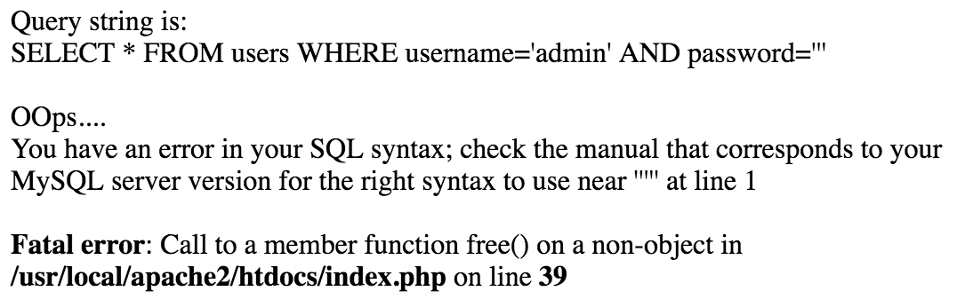
SQLi - Detection
Beyond the basics

Slide 11
SQLi - Detection
Digging a little deeper
What if error messages are disabled?
We can query the database with true or false queries, and analyse the responses.
http://books.com/item.php?id=2 and 1=2
http://books.com/item.php?id=2 and 1=1
We can use functions such as sleep(5) to see if our query is executed.
http://books.com/item.php?id=2 and sleep(5)
Beyond the basics

Slide 12
SQLi - Multibyte Attacks
Multibyte SQLi
Problems can arise when applications and databases interpret data differently…
Most systems use UTF-8, but historically, many systems use different character encodings.
GBK: Simplified Chinese
Big5: Traditional Chinese
Shift_JIS: Japanese
UTF-8: Covers most major languages
Beyond the basics

Slide 13
SQLi - Multibyte Attacks
Multibyte SQLi
Let’s take an example from GBK
The character 縗 is %BF%5C
In UTF-8 the encoding %BF%5C is ?\
Character | From UTF-8
' | %27
( | %28
) | %29
\ | %5C
Beyond the basics

Slide 14

SQLi - Multibyte Attacks
Multibyte SQLi
%BF%5C
Application 1 thinks %BF%5C is 縗 because it is using GBK
Application 2 thinks %BF%5C is ?\ because it is using UTF-8
Beyond the basics

Slide 15
SQLi - Multibyte Attacks
Input sanitising
In many languages we can simply sanitise input with built-in functions.
For example, in PHP we can use:
addslashes()
mysql_escape_string()
But both of these check characters byte by byte…
‘ will have a slash added to it,
and become \’
Beyond the basics

Slide 16
SQLi - Multibyte Attacks
Input sanitising
%BF%27 becomes %BF%5C%27
The application basically goes:
%BF = not a special character, move to the next
%27 = special character ‘ add a \ then move to the next
Etc etc…
Beyond the basics

Slide 17
SQLi - Multibyte Attacks
Input sanitising
Since the database is using a different encoding scheme, it will read:
%BF%5C%27
縗‘
Beyond the basics

Slide 18
SQLi - Multibyte Attacks
Input sanitising
SQL injection!
SELECT COUNT(*)
FROM users
WHERE username=‘admin’ AND password=‘縗’’
We have our single quote back, which we can use for injection!
Instead of username=‘admin’ AND password=‘\’’
Beyond the basics

Slide 19
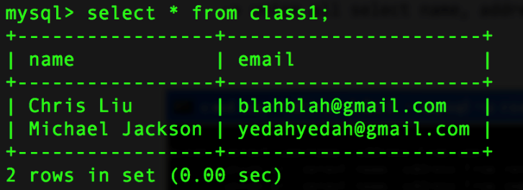
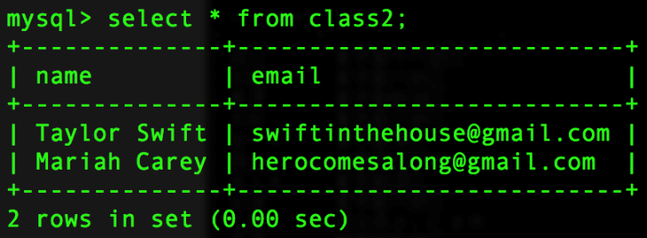
SQLi - UNION SELECT
Can we steal data from other tables? Oh yes…
Let’s take a look at UNION SELECT
Beyond the basics

Slide 20
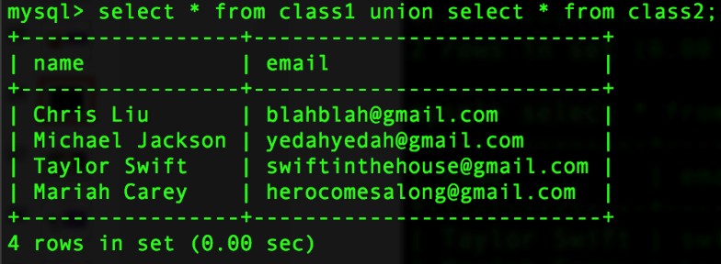
SQLi - UNION SELECT
Can we steal data from other tables? Oh yes…
Let’s take a look at UNION SELECT
Beyond the basics

Slide 21
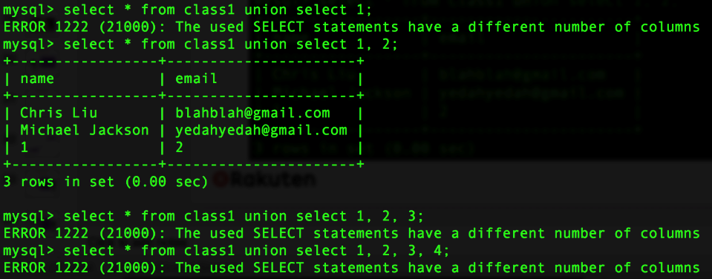
SQLi - UNION SELECT
UNION SELECT only works with the correct number of columns
Beyond the basics

Slide 22
SQLi - Introduction
So far we have covered:
SQLi basics
How to detect SQLi
Multibyte attacks
UNION SELECT attacks
Beyond the basics

Slide 23
SQLi - Introduction
General defences:
Proper escaping (don’t roll your own escaping, use functionality provided by your framework)
Use Prepared Statements
More info in the secure development training…
Beyond the basics

Slide 24



Want to learn more?
Thank you!
Want to learn more about Cyber Security?
Workshops
(see TECH HR confluence, or contact us for special topics)
Pa55word1 Live Stream
Join our monthly security webinar that includes live labs
Self study
Ask us for information on resources and certifications

